Slide 1
FPGA Implementation of a Discrete Fourier Transform
The Verigods
Issam Haddad
Peter Crary
Anthony Saab
Nick Palladino

Slide 2
Slide Assignments
Nick: 1, 3, 4
Anthony: 5, 6, 7 Iss: 8, 10, 11
Peter: 9, 12, 13

Slide 3
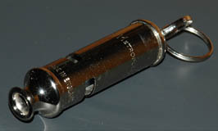
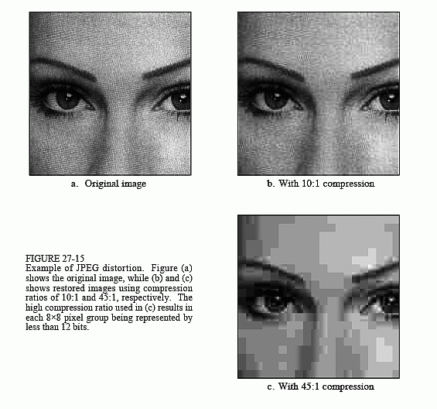
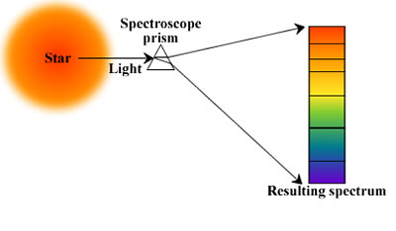
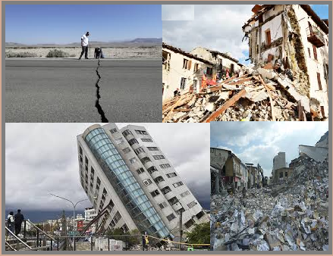
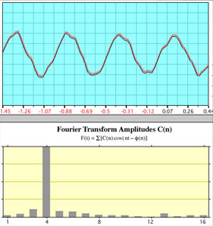
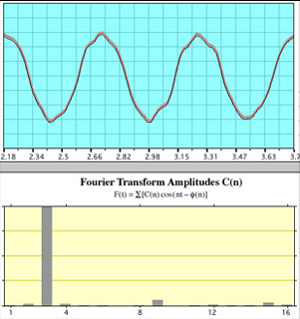
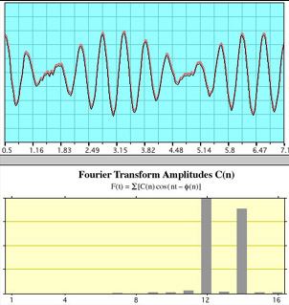
Goal/Motivation

Slide 4
Goals/Motivation
Analog + digital
Digital signal processing
Expandable
Audio analysis
Equalization

Slide 5
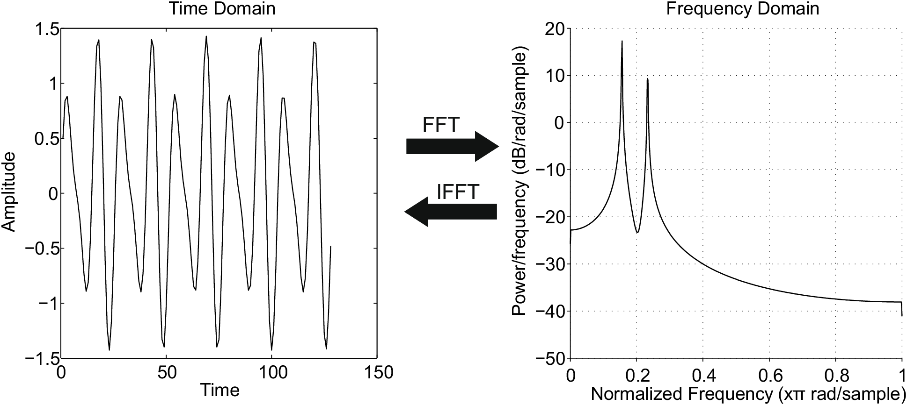
The Fourier Transform
Source: http://pyageng.mpastell.com/book/spectrum.html

Slide 6
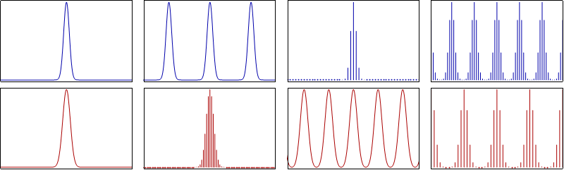

The Discrete Fourier Transform
Source: https://en.wikipedia.org/wiki/Discrete_Fourier_transform

Slide 7
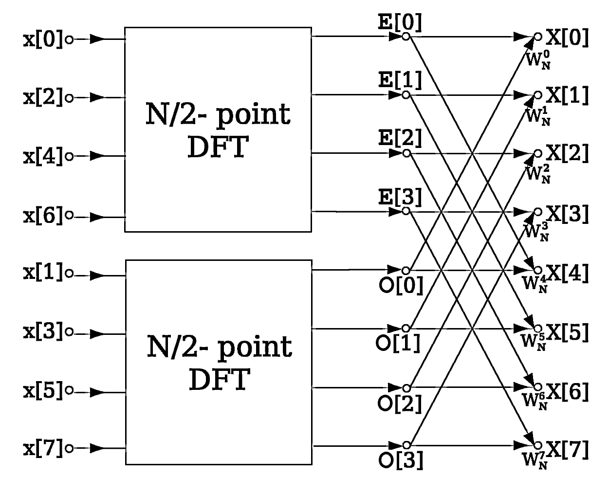
The Fast Fourier Transform
Source: https://en.wikipedia.org/wiki/Fast_Fourier_transform

Slide 8
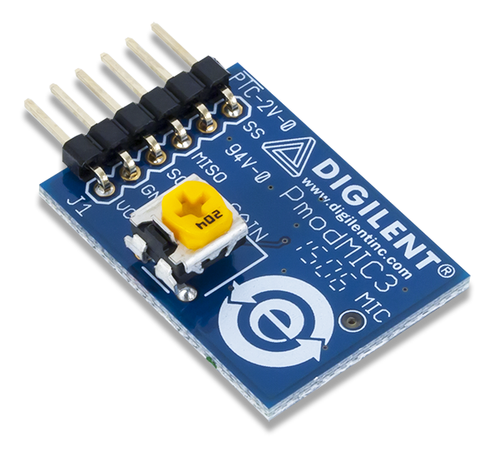
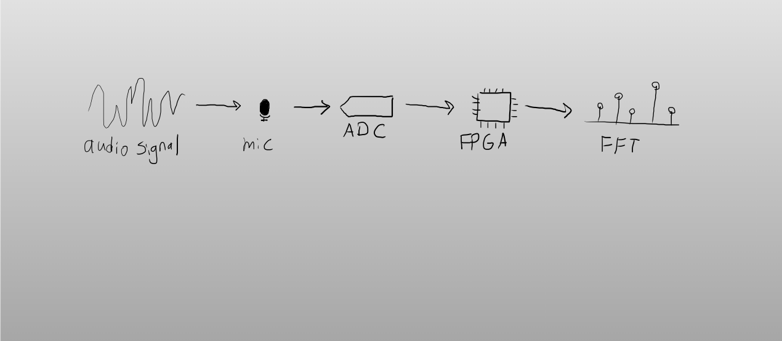
Functionality

Slide 9
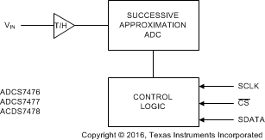
Specifications
Audio sampled up to 1 MSPS via Texas Instruments ADCS7476 12-bit ADC with SPI interface
Knowles Acoustics SPA2410LR5H-B MEMS microphone
16 Mhz clock generated by PLL for SPI and main clock
N-bin FFT is performed on all 12 bits (currently 8 bins)
https://github.com/ZipCPU/dblclockfft

Slide 10
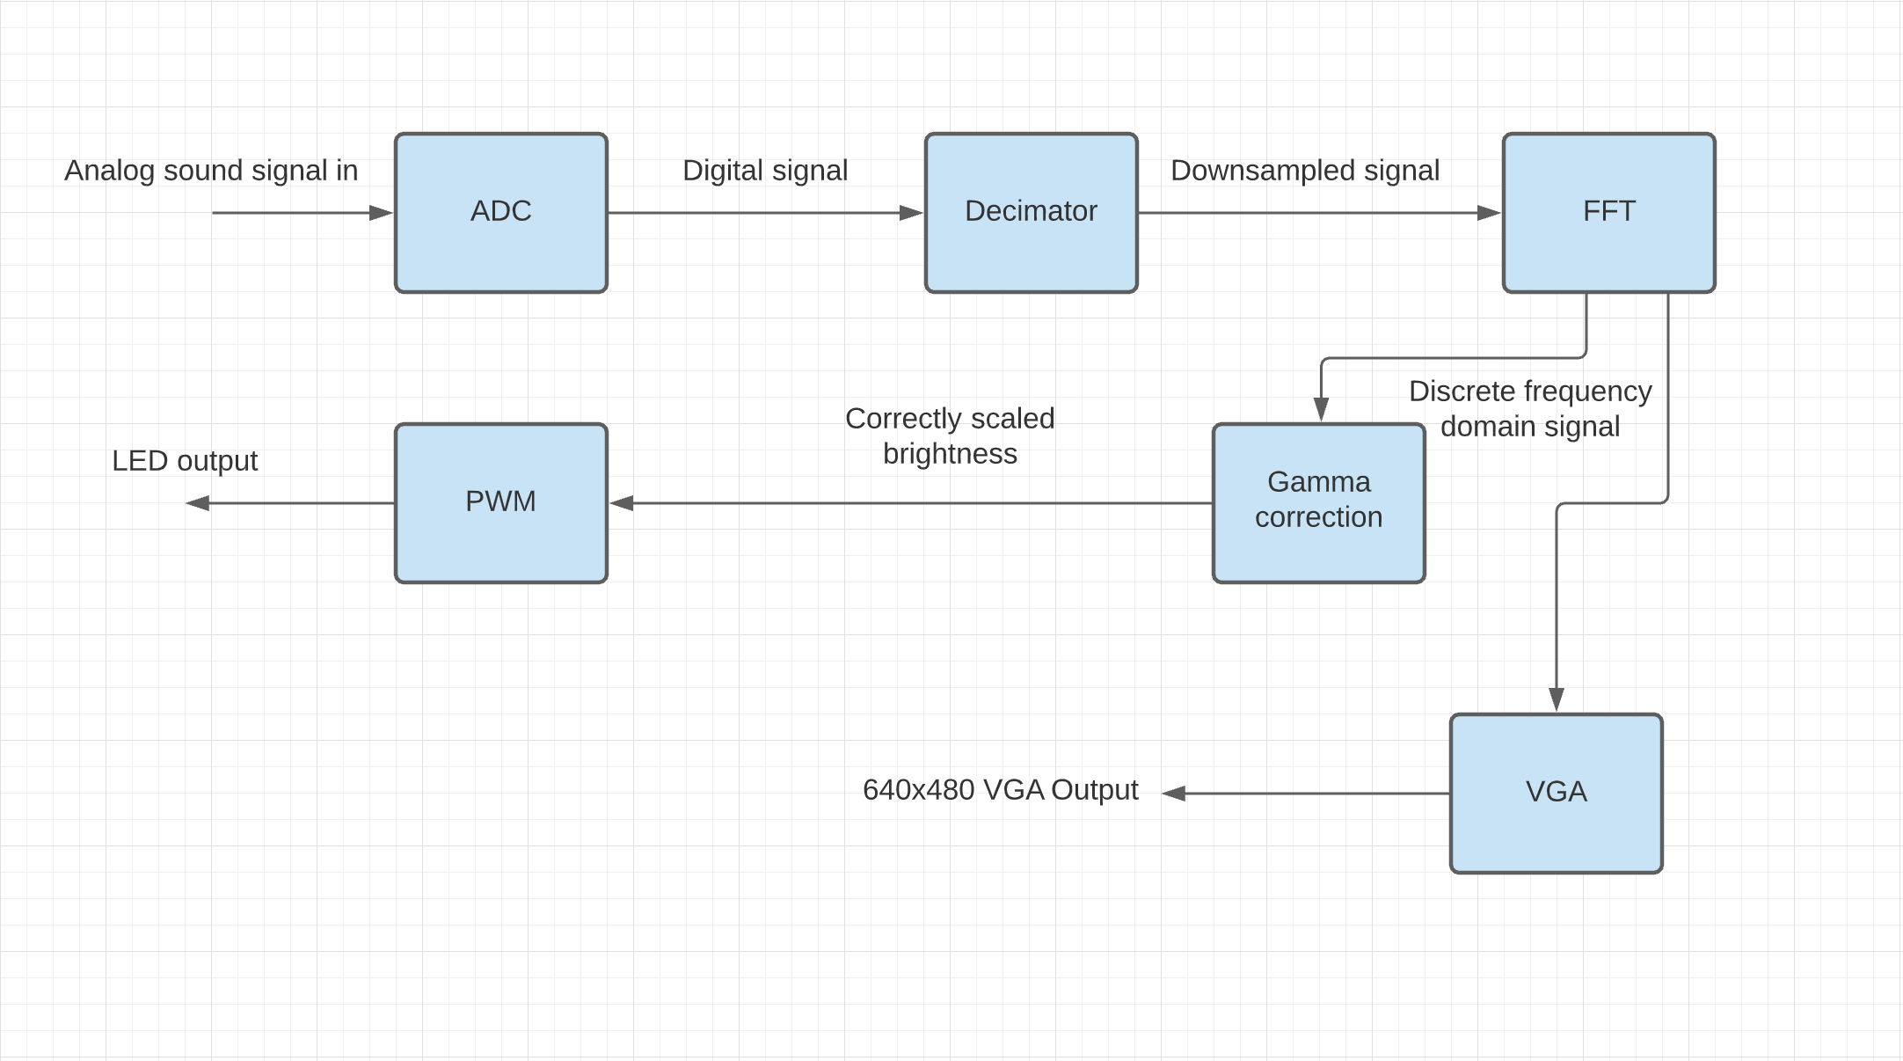
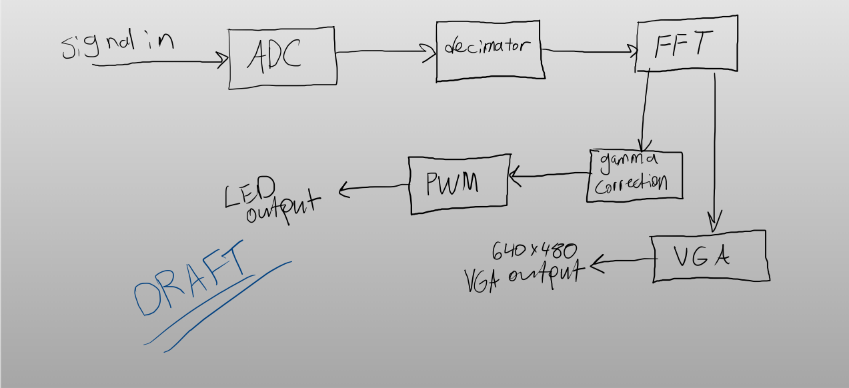
Detailed Block Diagrams

Slide 11
Code Snippet
always@(*) begin
draw = ((0 < sx) && (sx < 80) && (sy < bins[0])) ? 1 : 0;
draw = ((80 < sx) && (sx < 160) && (sy < bins[1])) ? 1 : 0;
draw = ((160 < sx) && (sx < 240) && (sy < bins[2])) ? 1 : 0;
draw = ((240 < sx) && (sx < 320) && (sy < bins[3])) ? 1 : 0;
draw = ((320 < sx) && (sx < 400) && (sy < bins[4])) ? 1 : 0;
draw = ((400 < sx) && (sx < 480) && (sy < bins[5])) ? 1 : 0;
draw = ((480 < sx) && (sx < 560) && (sy < bins[6])) ? 1 : 0;
draw = ((560 < sx) && (sx < 640) && (sy < bins[7])) ? 1 : 0;
VGA_R = !de ? 4'h0 : (draw ? 4'hF : 4'h2);
VGA_G = !de ? 4'h0 : (draw ? 4'hF : 4'hF);
VGA_B = !de ? 4'h0 : (draw ? 4'h2 : 4'hF);
end

Slide 12
Successes
Microphone signal input to FFT via ADC
Downsampling module synchronized with ADC and FFT
LEDs displaying FFT output via PWM
VGA set up to roughly display FFT output
Successful pipeline FFT data path

Slide 13
Failures
Did not implement colorful visualization over VGA yet
No filtering or windowing functions for ADC data
Need to implement better buffering/ frame processing for VGA output
Smoothing, averages, etc.
Limited to audio signals sampled from single microphone
Did not utilize pulse density modulated microphone included on Nexys A7
Have not expanded quantity of bins and sampling frequency

